Slide 1


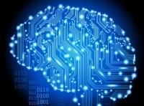
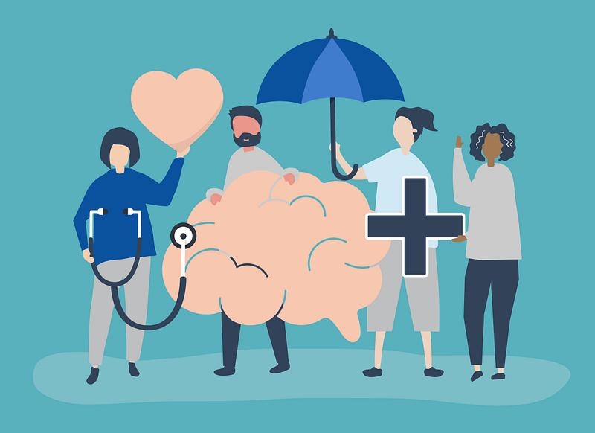
AI-Driven Mental Health Monitoring and Support
By- pce young coders
surya
vasugi
dewansh

Slide 2
introduction
Mental health disorders are patterns of symptoms
psychological, behavioral, or both — that cause distress and can have negative effects on your personal, social, or work life . Mental health disorders are characterized by issues regarding mood, thoughts, and behavior. They may also be referred to as psychological disorders, mental illnesses, and mental health conditions.

Slide 3
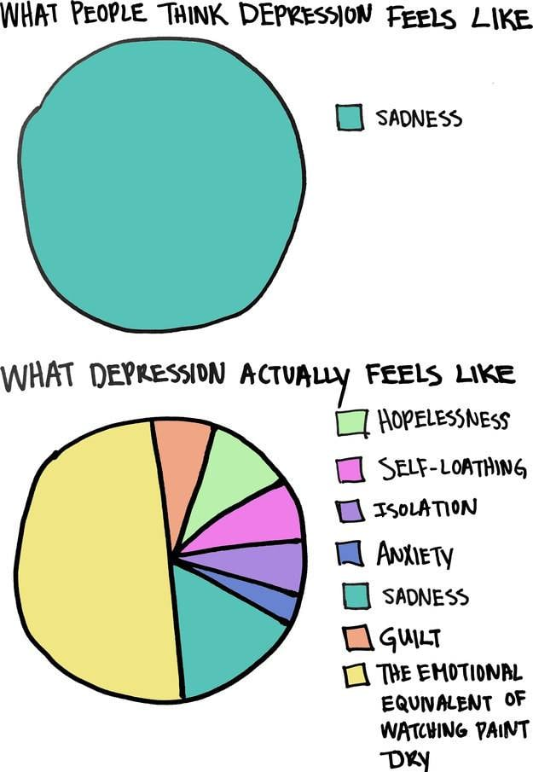
according to national institute of mental health , mental illness affects around 1 in 5 adults. Depressive disorders and anxiety disorders are among the most common mental health disorders. The rates are higher in females, young adults, and adults.
* Common mental health issues :-
->depression
->Anxiety disorder
->Bipolar disorder
->addictive behaviours
->schizophrenia(hallucinations)
->sleep disorder
->panic attacks

Slide 4
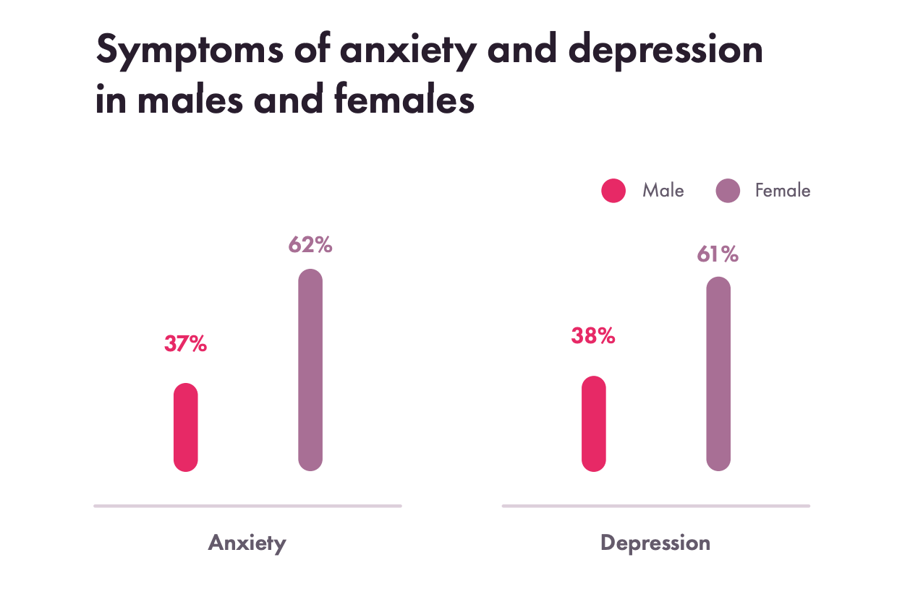
1 out of 3 women and 1 out of 5 men suffer from depression and mental health issues.
“Who” has already cleared that there is no health without mental health.
Women are more prone to mental health issues. There are many factors that are thought to increase women’s vulnerability to mental health disorders. These factors relate to their biological makeup as well as their specific experiences as women in society.
For example- women are usually judged based on their body structure making them meet up society borne expectations .

Slide 5
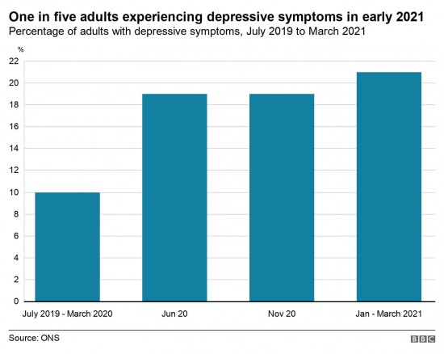
Depressive symptoms in 2021
1 IN 5 ADULTS EXPERIENCE DEPRESSIVE SYMPTOMS. THERE IS AN INCREASE OF RISE IN MENTAL HEALTH ISSUES SINCE COVID PANDEMIC.
WE CAN SEE THAT SUDDEN INCREASE IN CASES ADTER MARCH 2020 THAT IS, WHEN PANDEMIC STARTED.
PEOPLE SSTARTED CONSUMING ONLINE CONTENT AGRESSIVELY.

Slide 6
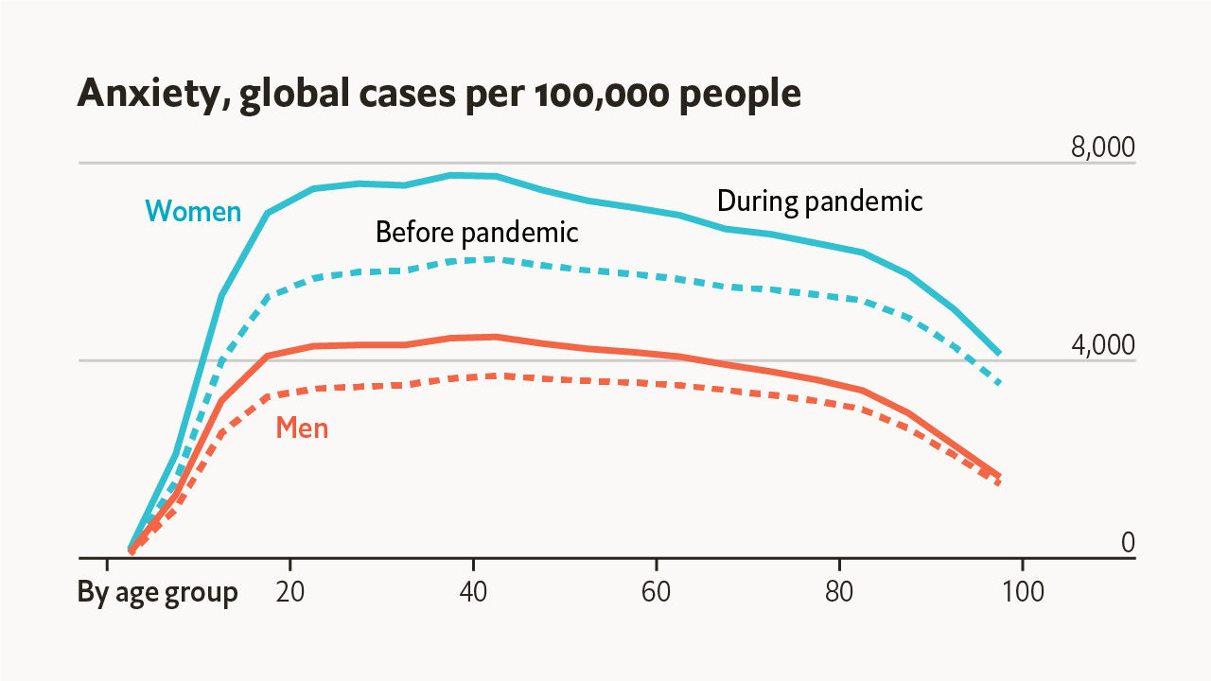
WE CAN SEE THAT ESPECIALLY DURING THE PANDEMIC THE MENTAL HEALTH ISSUE CASES ROSE VERY HIGH.
THE DIFFERENT TYPE OF ONLINCE CONTENT STARTED TO RISE FAST, MAKING THE EMOTIONAL CHANGES MUCH MORE THAN NORMAL AVRAGE.

Slide 7
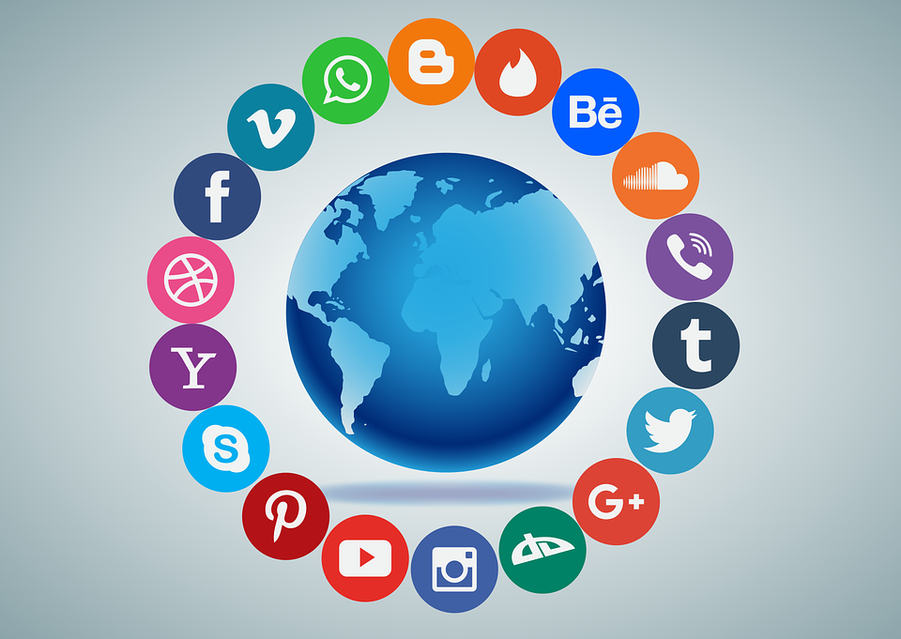
SOCIAL MEDIA A GREAT CAUSE FOR MENTAL HEALTH ISSUES
ON AN AVERAGE A HUMAN CHANGES THEIR EMOTIONS 12 TIMES AN HOUR BUT DUE TO SOCIAL MEDIA CONTENT INTAKE THE AMOUNT HAS ALMOST TRIPLED THAT IS 34 TIMES AN HOUR.
EMOTIONAL CHANGES PLAY A MAJOR ROLE IN MENTAL HEALTH ISSUE AS RESEARCHED BY ‘WHO’.
IT CLEARLY INDICATES THAT SOCIAL MEDIA DIRECTLY EFFECTS MENTAL HEALTH.

Slide 8
Problem statement
Many individuals with mental health issues do not receive timely intervention due to the stigma and lack of accessible resources. Create an AI system that monitors users’ mental health through their interactions (e.g., text, voice) and provides real-time support and resources tailored to their needs.
objective
Promote mental well-being by offering an unobtrusive and accessible AI-based tool that helps detect early signs of mental health issues and provides personalized support.

Slide 9

The Importance of Early Diagnosis and Treatment
Early diagnosis and treatment of mental health disorders are crucial for improving patient outcomes. Prompt intervention can -
-Prevent the progression of mental illnesses
-Reduce the severity of symptoms
-Enhance the effectiveness of treatment plans

Slide 10
Solution design
OUR MAIN GOAL IS TO INTERCEPT THE ISSUE BEFORE HAND AND GIVE A PROPER PERSONILISED SUPPORT FOR THE USER.
AS WE HAVE SEEN SOCIAL MEDIA PLAYS IMPORTANT ROLE in affecting the mental health issue of its users, we need to tackle down the problem from there itself.
By analyzing the time , content , search and sentiments on social media of a user can give us great data about the present mood and any behavioral changes of user suddenly.
There are many ways to perform proper social media analysis using ai for mental health issues.

Slide 11
Monitoring user interaction on social media platform (DETECTION)
TEXT ANALYSIS : MONITOR USER TEXT INPUTS IN SOCIAL MEDIA FOR SIGNS OF MENTAL DISTRESS.
IMAGE AND VIDEO ANALYSIS :USE COMPUTER VISION TO ANALYZE IMAGES AND VIDEOS POSTED BY USERS FOR SIGNS OF MENTAL HEALTH ISSUES, SUCH AS CHANGES IN APPEARANCE, EXPRESSION OF SELF-HARM, OR INDICATIVE SYMBOLS.
NATURAL LANGUAGE PROCESSING : UTILIZE ADVANCED NLP TECHNIQUES TO DETECT SIGNS OF DISTRESS, SADNESS, ANXIETY, OR OTHER MENTAL HEALTH INDICATORS IN REAL-TIME

Slide 12
BEHAVIOURAL ANALYSIS : MONITOR CHANGES IN INTERACTION PATTERNS, SUCH AS DECREASED ACTIVITY, WITHDRAWAL FROM SOCIAL INTERACTIONS, OR CHANGES IN THE FREQUENCY AND NATURE OF POSTS.
ACTIVITY MONITORING : USE MACHINE LEARNING MODELS TO DETECT ANOMALIES IN USER ACTIVITY THAT MAY INDICATE A MENTAL HEALTH CRISIS, SUCH AS SUDDEN SPIKES OR DROPS IN POSTING FREQUENCY.
SOCIAL NETWORK ANALYSIS: ANALYZE SOCIAL NETWORKS TO IDENTIFY INFLUENCE PATTERNS AND HOW INTERACTIONS WITH CERTAIN USERS AFFECT MENTAL HEALTH.

Slide 13
DIAGNOSIS USING THE DATA ANALYZED USING SOCIAL MEDIA
RISK PREDICTION : DEVELOPING PREDICTIVE MODELS TO IDENTIFY USERS AT RISK OF MENTAL HEALTH ISSUES BASED ON HISTORICAL DATA AND CURRENT BEHAVIOR.
PERSONALIZED FEEDBACK: PROVIDE USERS WITH FEEDBACK ON THEIR EMOTIONAL TRENDS AND SUGGEST INTERVENTIONS IF NEGATIVE TRENDS ARE DETECTED.

Slide 14
AI CHATBOX : AI-DRIVEN CHATBOTS THAT CAN ENGAGE WITH USERS IN REAL-TIME CONVERSATIONS TO ASSESS THEIR MENTAL STATE AND PROVIDE SUPPORT OR RESOURCES.
PERSONALIZED CONTENT RECOMMENDATIONS : RECOMMENDATION ALGORITHMS TO SUGGEST SUPPORTIVE AND UPLIFTING CONTENT TO USERS SHOWING SIGNS OF MENTAL HEALTH ISSUES.
PERSONEL MC STORY : MAKING USE OF AI TO CREATE STORYS BASED ON USERS PERSONEL FEEDBACKS AND HISTORY, MAKING HIM THE MAIN CHARACTER IN THAT STORY AND UPLIFTING THE MOOD OF USER.
FEEDBACK : FEEDBACK USED TO COLLECT ALL DATA AND MAKE THE AI BETTER FOR FUTURE PROBLEMS.

Slide 15
DRAWBACKS
PRIVACY AND CONSENT: ENSURE USER DATA PRIVACY AND OBTAIN EXPLICIT CONSENT BEFORE MONITORING AND ANALYZING THEIR SOCIAL MEDIA ACTIVITY.
BIAS AND FAIRNESS : ADDRESS BIASES IN AI MODELS TO AVOID MISDIAGNOSIS OR UNFAIR TREATMENT.
TRANSPARENCY: BE TRANSPARENT ABOUT DATA USAGE AND THE PURPOSE OF MONITORING AND PROVIDE USERS WITH CONTROL OVER THEIR DATA.

Slide 16
conclusion
LEVERAGING AI FOR DETECTING MENTAL HEALTH ISSUES ON SOCIAL MEDIA IS A PROMISING APPROACH FOR EARLY INTERVENTION AND SUPPORT. TECHNIQUES LIKE NATURAL LANGUAGE PROCESSING (NLP) FOR SENTIMENT ANALYSIS, COMPUTER VISION FOR CONTENT ANALYSIS, AND MACHINE LEARNING FOR BEHAVIORAL DETECTION CAN PROVIDE VALUABLE INSIGHTS INTO USERS' MENTAL WELL-BEING. PREDICTIVE ANALYTICS AND LONGITUDINAL SENTIMENT ANALYSIS ENHANCE THE ABILITY TO IDENTIFY AT-RISK INDIVIDUALS AND OFFER TIMELY ALERTS.
AI-DRIVEN CHATBOTS AND VIRTUAL ASSISTANTS PROVIDE REAL-TIME, PERSONALIZED SUPPORT, WHILE INTEGRATING SOCIAL MEDIA DATA WITH WEARABLES AND IOT DEVICES ALLOWS COMPREHENSIVE MONITORING AND INTERVENTIONS. ETHICAL CONSIDERATIONS, INCLUDING USER PRIVACY, CONSENT, BIAS, AND TRANSPARENCY, ARE CRUCIAL FOR RESPONSIBLE IMPLEMENTATION.
BY BALANCING INNOVATION WITH ETHICAL RESPONSIBILITY, AI CAN SIGNIFICANTLY IMPROVE EARLY DETECTION AND SUPPORT FOR MENTAL HEALTH ISSUES ON SOCIAL MEDIA, CREATING A MORE SUPPORTIVE DIGITAL ENVIRONMENT.

Slide 17

- TEAM PCE YOUNG CODERS

